Slide 1

Coumarane COUPPANE Developer Full-Stack - @Devoteam
Initiation à Reactjs

Slide 2
Sujets abordés:
C’est quoi Reactjs
Comparaison & Stats
Nouvelles fonctionnalités Javascript(ES6)
Outils de développement
Composants
JSX, Virtual DOM, Props, State, Cycle de vie
Communication entre composants
Comment déployer l’application
Démo app gestion de contact

Slide 3
React: c’est quoi?
Reactjs est une librairie libre créée par Facebook en 2013.
Facilite la création d’application monopage ou SPA (Single Page Application)
Fournit seulement la vue V du framework MVC (Model Vue Controller)
Server Side Rendering
Components
Virtual DOM
Cycle de vie
JSX

Slide 4
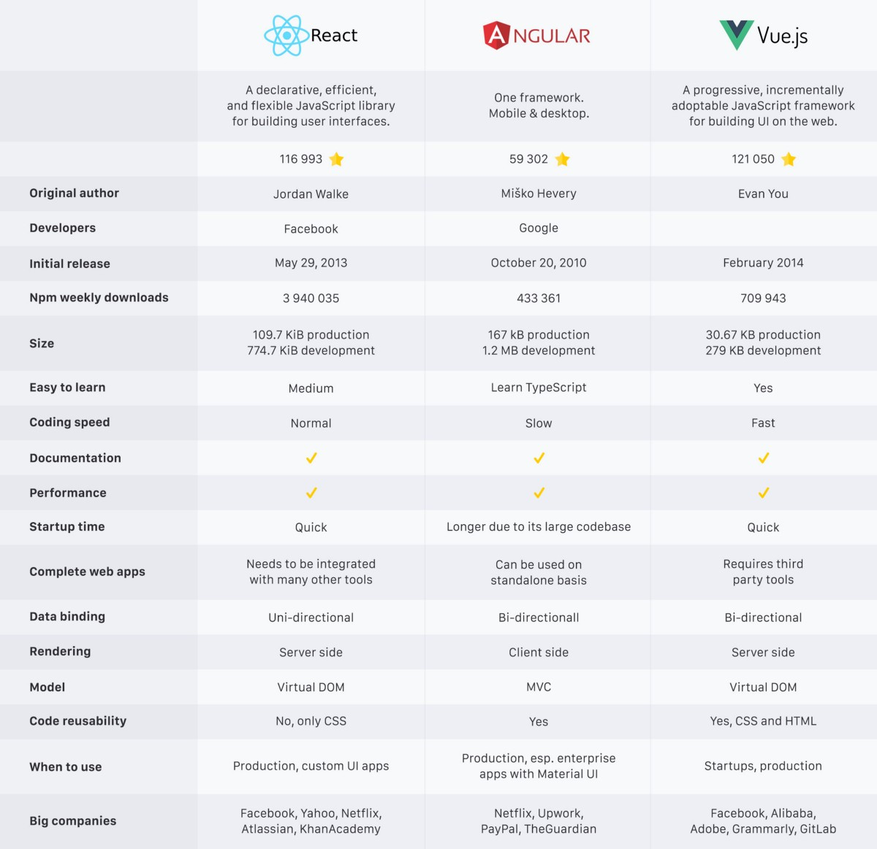
Comparaison
https://medium.com/@rahul77349/react-vs-angular-vs-vue-js-which-one-should-i-learn-in-2019-23ec05a49f78

Slide 5
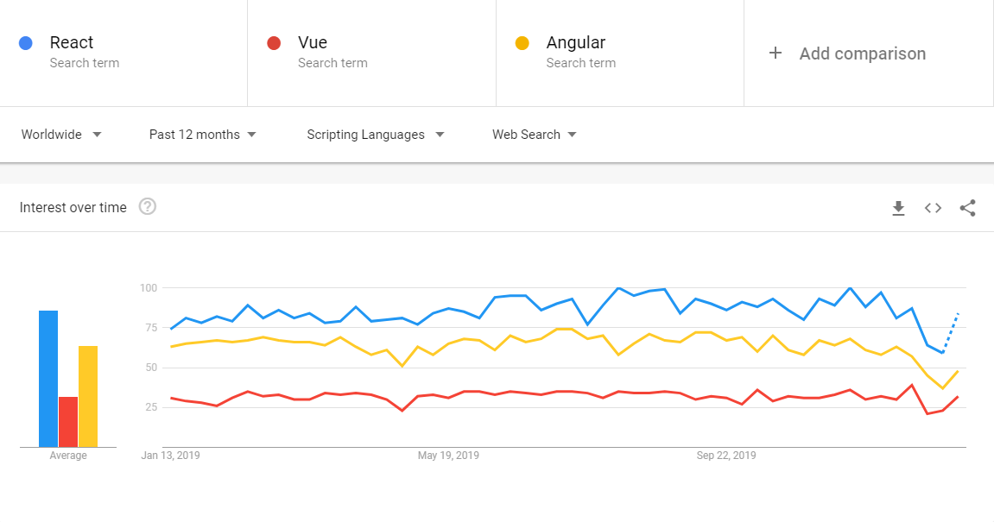
Stats
https://trends.google.com/trends/explore?cat=733&q=React,Vue,Angular

Slide 6
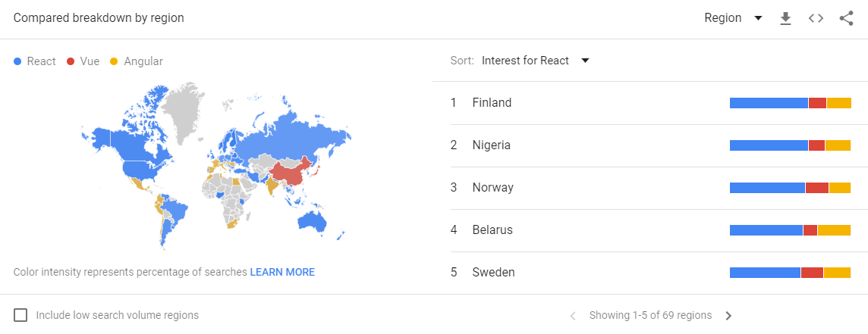
Stats (suite)
https://trends.google.com/trends/explore?cat=733&q=React,Vue,Angular

Slide 7







Qui utilise React?

Slide 8








Outils de développement
Nodejs (plate-forme javascript orienté serveur)
Create-React-App (outil Facebook incluant babel et webpack)
Git (gestion de versions de code)
Editeur de code (exemple: vscode)

Slide 9
Nouvelles fonctionnalités Javascript(ES6)
Module (import, export)
Constants, let
Default arguments
String interpolation
Property shorthands
Rest parameter & Spread operators
Object & array destructuring
Arrow functions (lambda expressions)
Promises
Classes & class inheritance
Toutes les fonctionnalités: http://es6-features.org

Slide 10
Components
<div>
<button>
API Json
const contacts: IContact[] = [
{id: 1, name: 'Coumarane COUPPANE', dateOfBirth: '24/07/1975', email: 'c.coumarane@gmail.com'},
{id: 2, name: 'Helios', dateOfBirth: '01/01/2020', email: 'helios@mail.me'}
]
props
<ContactList datas={contacts} />

Slide 11
Components – Function Component
import * as React from "react";
import { IContact } from "../../models/contact";
interface IOwnProps {
datas: IContact[];
}
const ContactList: React.FunctionComponent<IOwnProps> = props => {
return (
<>
<h6>Contact list</h6>
<div>
{props.datas && props.datas.length > 0 && props.datas.map((item, index) => {
return (
<React.Fragment key={index}>
<div>{item.id}</div>
<div>{item.name}</div>
<div>{item.email}</div>
<div>{item.dateOfBirth}</div>
</React.Fragment>
);
})}
</div>
</>
);
};
export default ContactList;

Slide 12
Components – Class Component
import * as React from "react";
import { IContact } from "../../models/contact";
interface IOwnProps {
datas: IContact[];
}
class ContactList extends React.Component<IOwnProps> {
render() {
const { datas } = this.props;
return (
<>
<h6>Contact list</h6>
<div>
{datas && datas.length > 0 && datas.map((item, index) => {
return (
<React.Fragment key={index}>
<div>{item.id}</div>
<div>{item.name}</div>
<div>{item.email}</div>
<div>{item.dateOfBirth}</div>
</React.Fragment>
);
})}
</div>
</>
);
}
}
export default ContactList;

Slide 13
Components – Utilisation
import * as React from "react";
import { IContact } from "../../models/contact";
import ContactList from "./contact.list";
const contactList: IContact[] = [
{ id: 1, name: "Coumarane COUPPANE", dateOfBirth: "24/07/1975", email: "c.coumarane@gmail.com" },
{ id: 2, name: "Helios", dateOfBirth: "01/01/2020", email: "helios@mail.me" }
];
interface IOwnState {
contacts: IContact[];
}
class Contact extends React.Component<{}, IOwnState> {
constructor(props: {}) {
super(props);
this.state = {
contacts: contactList
};
}
render() {
return (<><ContactList datas={this.state.contacts} /></>);
}
}
export default Contact;

Slide 14
JSX
Javascript + XML

Slide 15
Virtual DOM
DOM (Document Object Model) https://developer.mozilla.org/fr/docs/Web/API/Document_Object_Model:
- C’est une interface de programmation pour les documents HTML, XML, SVG.
- Language de programmation utilisé est Javascript
Virtual DOM est une
html
head
body
title
meta
style
script
div
h1

Slide 16
Props
xx

Slide 17
State
xx

Slide 18
Cycle de vie
xx

Slide 19
Introduction React Hooks
xx

Slide 20
Comment déployer l’application
https://www.codemag.com/Article/1809041/Demystifying-React

